Slide 1
Containerization and Docker
Hany Hesham

Slide 2
Outline
1
What is Containerization?
2
Why it's important for modern application development and deployment ?
3
What is Docker and how it enables containerization ?
4
What are Docker images and containers ?

Slide 3
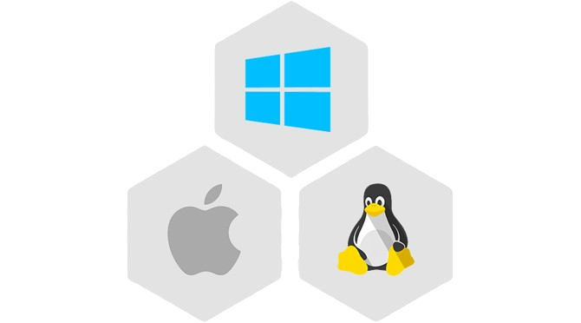
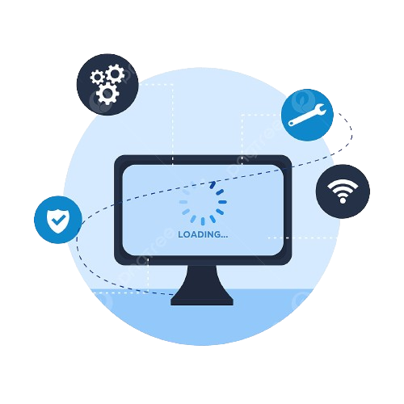

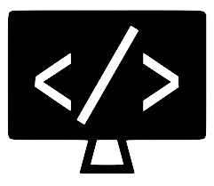
What is a software ?
OS
Run Time Engine
Your Custom Code
Software

Slide 4
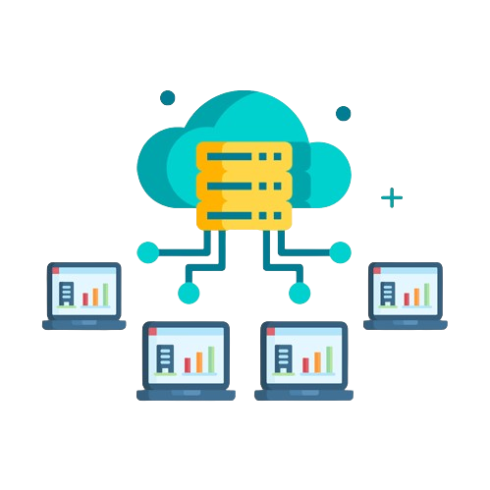
Virtualization
Spinning multiple servers on one powerful server

Slide 5
Virtualization Deployments
VM guest 1
VM guest 2
VM guest 3
Guest OS
Guest OS
Guest OS
Guest app 1
Guest app 1
Guest app 1
Guest app 2
Guest app 2
Guest app 2
Hypervisor (Xen or KVM)
VM host operating system
VM host physical system

Slide 6








Virtualizations Issues
Operation overhead for companies
Hard and very complex to Scale
Virtualizations Issues
Higher risk because of the hidden configurations and custom setup
Higher cost

Slide 7
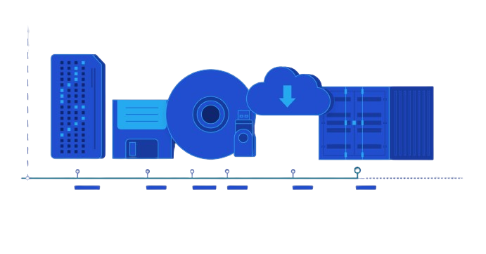
Containers
"Containers are packages of software that contain all of the necessary elements to run in any environment" - Google definition

Slide 8
What is Containerization ?
Containerization is a process of packaging an application and its dependencies into a self-contained unit that can run anywhere
Containerization allows developers to create and deploy applications faster, easier, and more reliably

Slide 9
What is Containerization ?
Containerization also enables applications to run in isolated environments, which improves security, performance, and resource utilization
Containerization is one of the key technologies behind the rise of cloud computing and microservices

Slide 10
What is Containerization ?
Control groups
You can use cgroups to limit resources.
This process can only use 256MB of memory and 1 vCPU
+
Namespaces
You can use namespace to isolate processes.
This process sees only its network traffic
= Containers

Slide 11
Containerization Benefits
Less hardware resources
4
1
Application isolation
Containerization benefits
Quick startup time
3
2
Constant deployment across multiple OS and environments

Slide 12
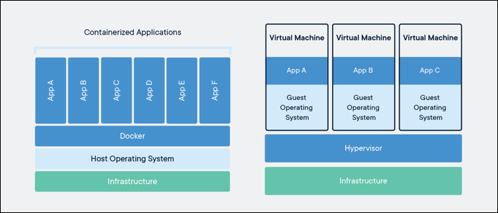
Virtualization VS Containerization

Slide 13
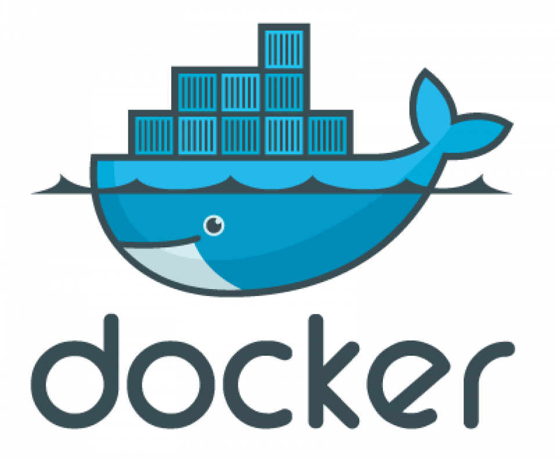
What is Docker?
Testing Docker is an open-source platform that provides tools and services for building running and managing containers
Docker uses a client-server architecture, where the Docker client communicates with the Docker daemon (or server) to perform various operations on containers

Slide 14
What is Docker?
Docker provides a registry services called Docker Hub, where you can store and share your container images
Docker supports multiple operating systems such as Linux , windows and macOS which make it perfect for development and deployment

Slide 15
What is Docker Image?
Docker images are the building blocks of containers, they are files that contain all information needed to create and run a container
Docker images are composed of layers, which are snapshots of the file system at different stages of the container creation process
Docker images are immutable, meaning they cannot be modified once they are created, instead we create different image tags

Slide 16
What is Docker Image?
Docker images can be created using a Dockerfile, which is a text file that contains instructions for building an image
Docker images can be shared and transferred to any registry
You can run as many containers as you can from one docker image

Slide 17
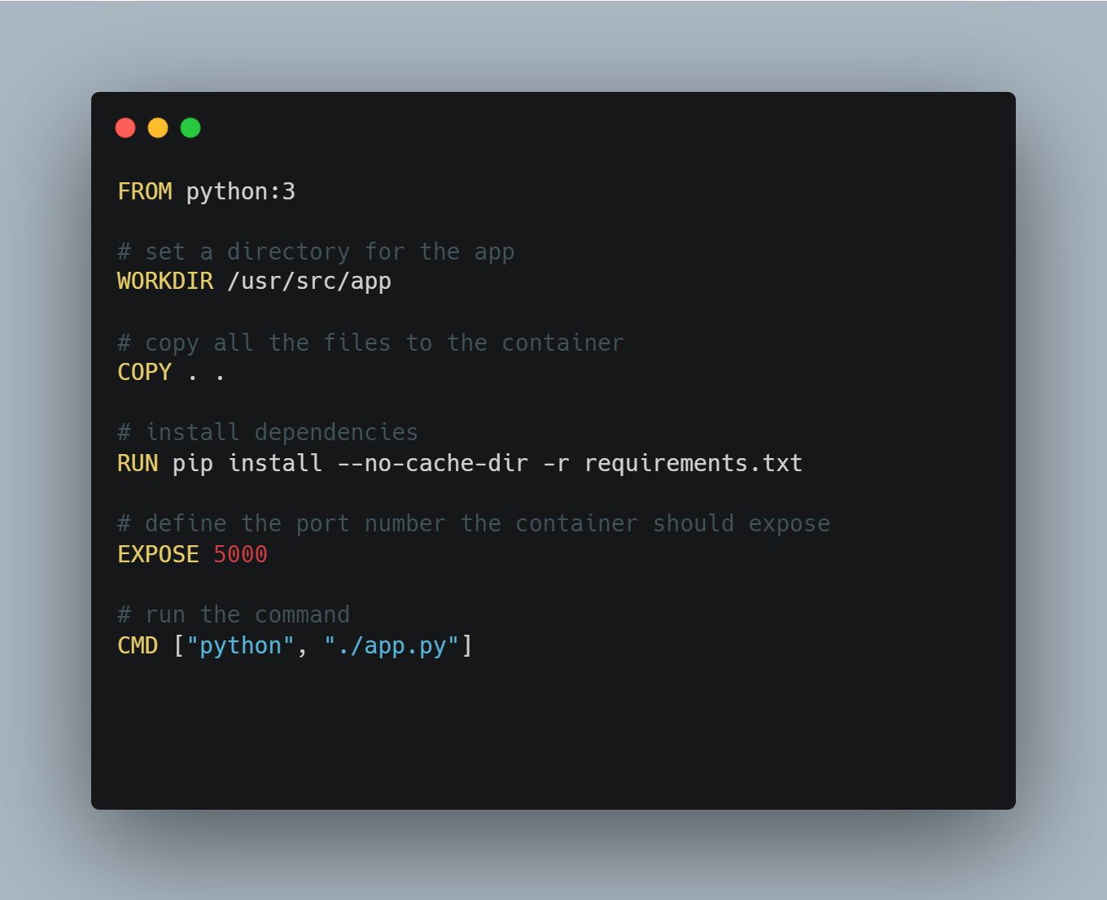

Dockerfile Example

Slide 18
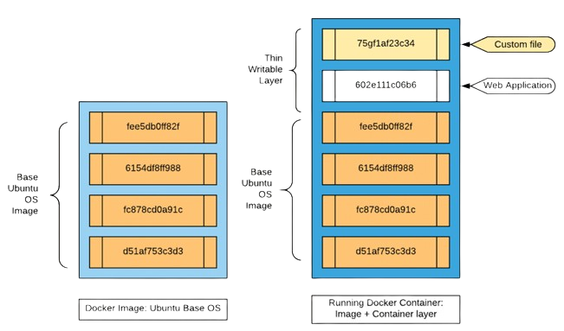
Dockerfile Example

Slide 19
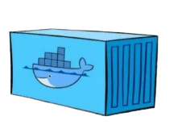
What is Docker Container?
Docker containers are instances of Docker images that run in an isolated environment
Contains can be created using the docker run command which takes an image name as an input and it start a docker container based on that image
You can run multiple containers and they can communicate with each others using the docker network

Slide 20
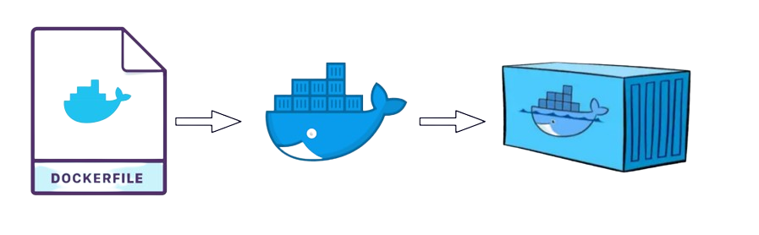
What is Docker Container?
Dockerfile
Docker Image
Docker Container

Slide 21

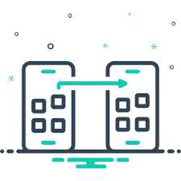


What is Docker Benefits?
Portability
Security
Docker containers can run on any platform that supports Docker, without requiring any change to the application code or configuration
Docker containers provide isolation and sandboxing for application which reduces the risk of malicious attacks or accidental errors
Scalability
Efficiency
Docker containers use less resources than traditional virtual machines, as they share the same kernel and do not need to run a separate operating system for each application
Docker containers can be scaled up or down according to the demand or resource availability

Slide 22
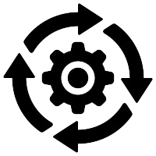


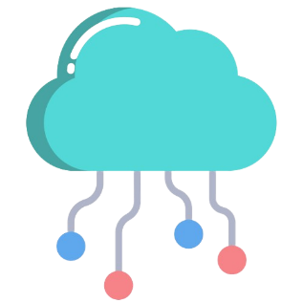
Docker Use Cases
Development
Production
Docker can be used to create consistent and reproducible development environment that match production environment
Docker can be used to deploy application in production environments with high availability, reliability and scalability
Testing
Cloud Computing
Docker can be used to automate and streamline the testing process by creating and destroying containers on demand
Docker can be used to leverage the benefits of cloud computing, such as elasticity, flexibility and cost-effectiveness

Slide 23
Conclusion
Containerization is a powerful technology that enables modern application development and deployment
Docker is a leading platform that provides tools and services for containerization
Docker offers many benefits for developers and operators such as portability, scalability, security and efficiency
Docker can be used for various scenarios, such as development, testing, and production

Slide 24
Workshop
Installation
Please follow the steps from this link to download and install Docker desktop on your laptop

Slide 25
Common Docker CLI
docker ps - list running containers
docker ps –a - list running & stopped containers
docker images - list available images
docker stop - stop container, provide Container ID
docker start - start stopped container, provide Container ID
docker restart - stop then restart container, provide Container ID
docker rm - remove stopped container, provide Container ID
docker rmi - remove image provide Image ID
docker kill - forcibly stop (kill) container, provide Container ID
https://dockerlabs.collabnix.com/docker/cheatsheet/

Slide 26
Exercise 1
Pull Nginx image
Run Nginx container
View running containers
Stop Nginx container
Restart Nginx container
Remove the Nginx container
Nginx: is open source software for web serving, reverse proxying, caching, load balancing, media streaming, and more

Slide 27
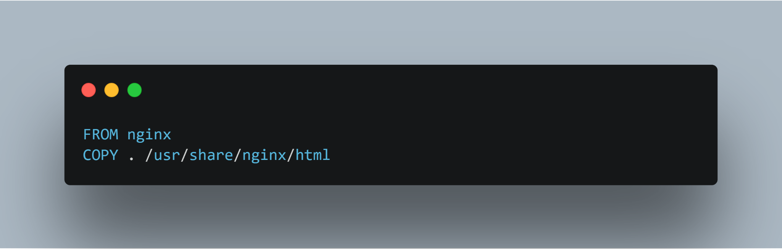
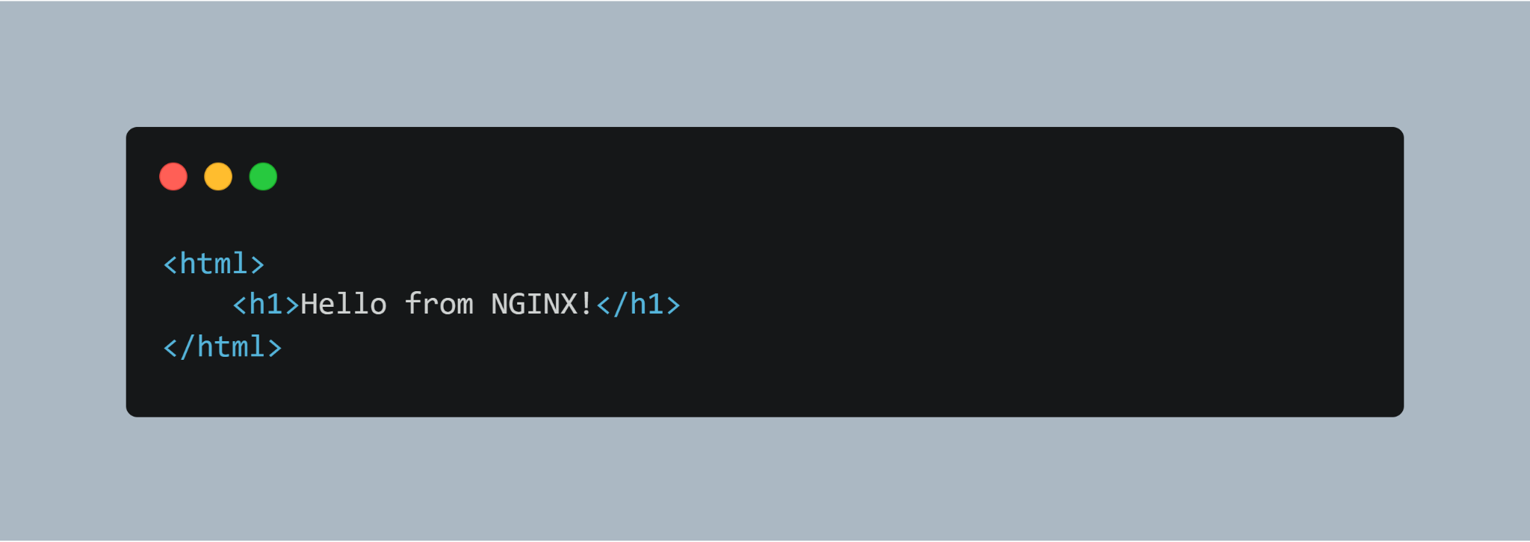
Exercise 2
Build and run a custom nginx Docker image with your own home page
Create a Dockerfile
Create a new file index.html
Build your image
Run a new container from your image

Slide 28


THANK YOU
www.sprints.ai

